Slide 1
AMAZON FILE TRANSFER
AWS Transfer Family is a secure transfer service that enables you to transfer files into and out of AWS storage services.
It provides way to exchange file between systems in secure manner(confidentiality integrity, authentication, privacy).
AWS Transfer Family supports transferring data from or to the following AWS storage services.
Amazon Simple Storage Service (Amazon S3) storage.
Amazon Elastic File System (Amazon EFS) Network File System (NFS) file systems.

Slide 2
Secure Shell File Transfer Protocol(SFTP)
Amazon File transfer:
It supports 3 file transfer protocals
SFTP---file transfer over secure shell(ssH)
FTPS---File transfer protocal with TLS encryption
FTP---unencrypted file transfer protocal

Slide 3
AMAZON FILE TRANSFER
File transfer protocols are used in data exchange workflows across different industries such as financial services, healthcare, advertising, and retail, among others .
It enables you to create SFTP servers in the cloud,which can be used to securely transfer files to and from Amazon buckets and EFS file system among other AWS supported AWS services.

Slide 4
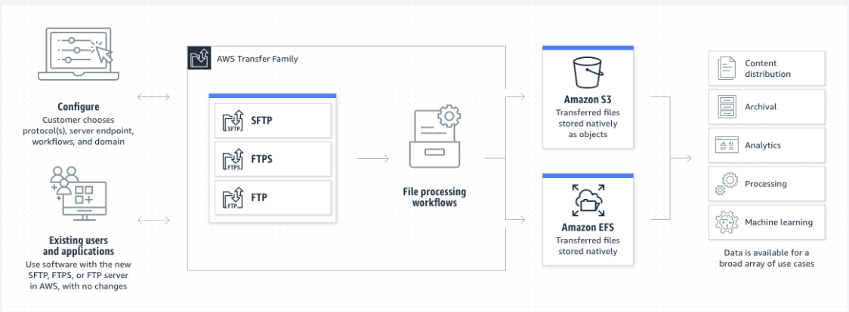
ARCHITECTURE

Slide 5
AMAZON FILE TRANSFER
Benefits:
1. Security: It uses the Secure Shell (SSH) protocol to encrypt data during transmission, ensuring the confidentiality and integrity of your files.
2. Managed Service: AWS takes care of the underlying infrastructure, reducing the operational overhead of managing your SFTP servers.
3. Scalability: You can easily scale your SFTP server resources up or down based on your needs, without worrying about hardware constraints.

Slide 6
AMAZON FILE TRANSFER
Benefits:
4. Integration: Amazon SFTP can be integrated with other AWS services like Amazon S3, Amazon EFS, and AWS Lambda, making it a versatile solution for file transfers within the AWS ecosystem.
5. Logging and Monitoring: It provides detailed logging and monitoring capabilities, allowing you to track file transfer activities.

Slide 7
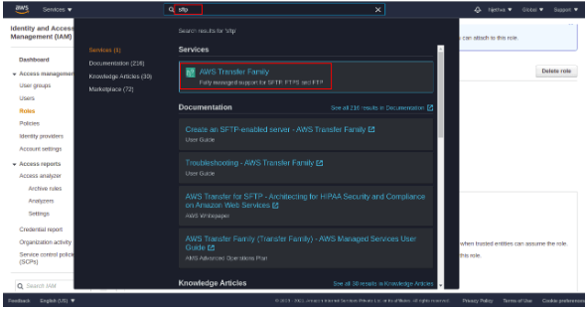
Steps to create an SFTP server
1. Search for SFTP on the search bar.

Slide 8
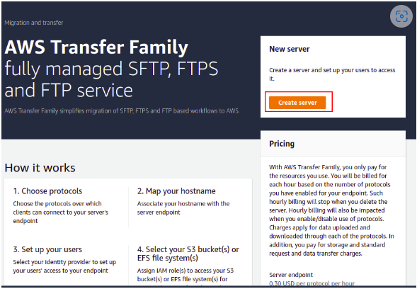
Steps to create a SFTP server
2. Click on AWS Transfer Family. You should see the AWS Transfer Family dashboard

Slide 9
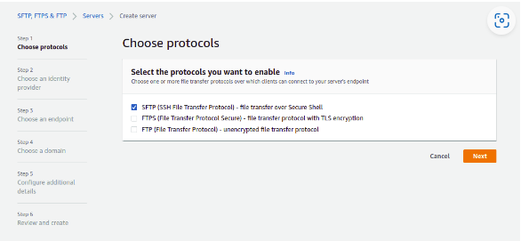
Steps to create a SFTP server
3. Click on the Create server button. You will be asked to choose the protocols

Slide 10
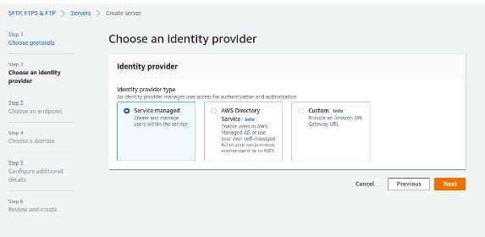
Steps to create a SFTP server
4. Select SFTP protocol and click on the Next button. You will be asked to select an identity provider

Slide 11
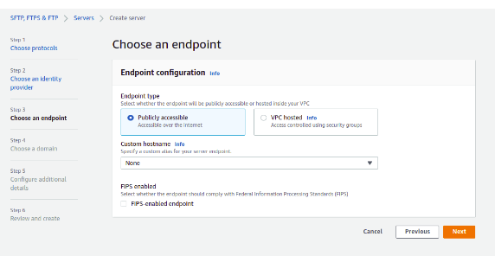
Steps to create a SFTP server
5. Select Service Manage and click on the Next button. You will be asked to select an endpoint

Slide 12
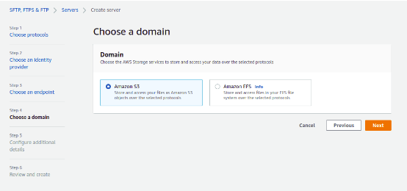
Steps to create a SFTP server
6. Select endpoint type(publicly accessible,VPC HOSTED), hostname, and click on the Next button. You will be asked to choose a domain(storage(s3,EFS)to store and access the data over selected protocal)

Slide 13
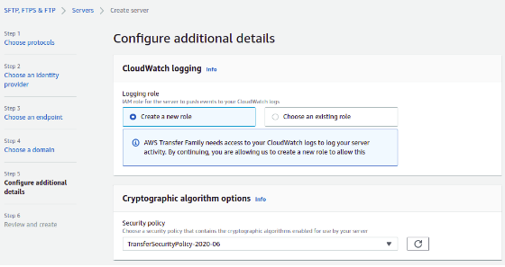
Steps to create a SFTP server
7. Select Amazon S3 and click on the Next button. You will be asked to configure additional details (cloud watch logging,server host key)

Slide 14
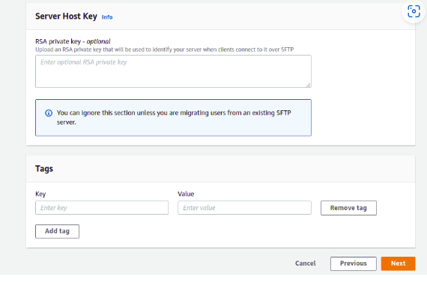
Steps to create a SFTP server
8. Provide relevant details and click on the Next button.

Slide 15
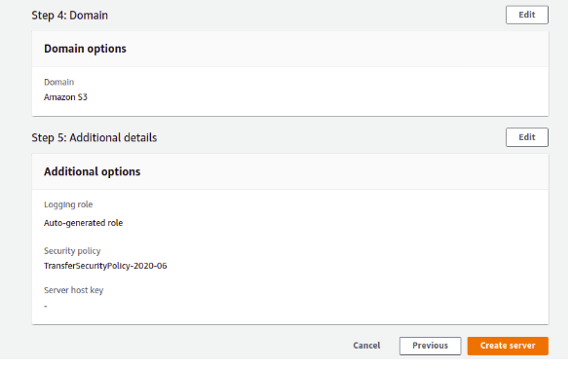
Steps to create an SFTP server
9. Review all the settings and click on the Create server button. Once the SFTP server has been created successfully

Slide 16
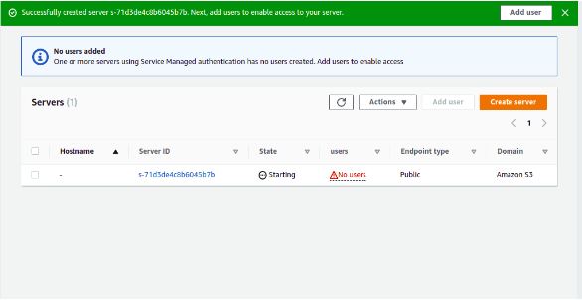
Steps to create an SFTP server
10. As you can notice, there are no users created yet, so click on the button Add User for creating users who will be accessing this sftp service. Next, click on your SFTP server.

Slide 17
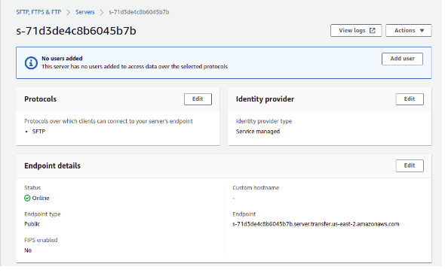
Steps to create an SFTP server

Slide 18
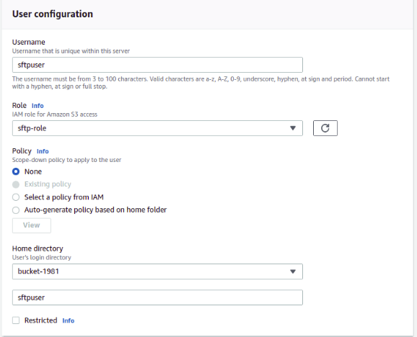
Steps to create an SFTP server
11. Now, click on the Add user button. You should see the user configuration page

Slide 19
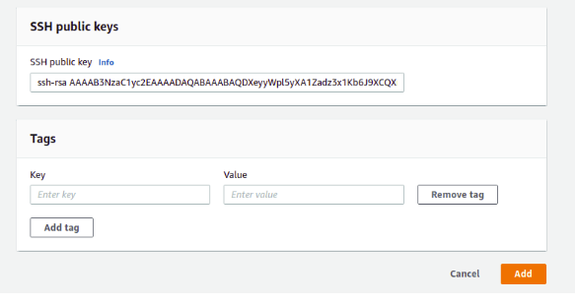
Steps to create an SFTP server

Slide 20
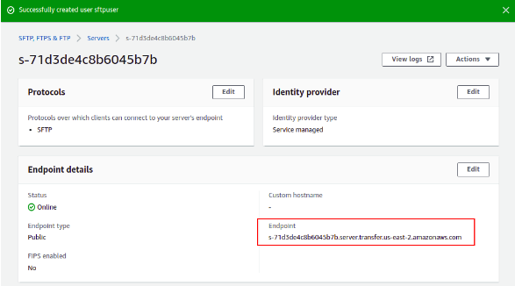
Steps to create a SFTP server
12. Next, provide your desired SFTP username, select the SFTP role we have created earlier, and select the S3 bucket we created earlier. You will also need to provide an SSH public key of the remote machine from where you want to access the SFTP server.

Slide 21
Use cases
Data Backup and Recovery
Data Ingestion
File Sharing
Log and Data Transfer
Content Distribution
Migration and Data Transfer
Data Exchange with IoT Devices
Data Integration

Slide 22
SFTP Billing
For data upload and download: At $0.04/GB, monthly charge for data uploads and downloads is: $0.04 * 200 GB * 30 days (uploads) + $0.04 * 100 GB * 30 days (downloads) = $240 + $120 = $360.
AWS Transfer Family has predictable, usage-based pricing. You pay only for the protocols enabled on your endpoint(s) in addition to the amount of data (gigabytes) uploaded and downloaded over SFTP/FTPS/FTP, or the number of messages sent and received over AS2, or the amount of data processed using AWS Transfer Family Workflows.
Time each protocol is enabled | $0.30 per hour per protocol
Data uploads | $0.04 per gigabyte (GB) transferred
Data downloads | $0.04 per gigabyte (GB) transferred

Slide 23
SFTP Billing
When using SFTP connectors to connect to remote SFTP servers, you pay for the number of connector calls and the amount of data sent or retrieved.
You can choose up to 3 Availability Zones (AZs) for Transfer Family servers. There is no additional cost associated with having multiple AZs for a server.

Slide 24
SFTP Billing
Data Transfer Charges: You'll be billed for the data transferred in and out of your SFTP server. This includes both uploading and downloading files. The cost varies based on the AWS region and the amount of data transferred.
Endpoint Hours: You're billed for the time your SFTP server endpoints are provisioned. This covers the server resources needed to manage SFTP connections, regardless of whether data is being transferred at that time.
Pay-as-you-go pricing for data transferred: This includes the data transferred in (data uploaded to your SFTP server) and the data transferred out (data downloaded from your SFTP server). The cost varies depending on the AWS region you're using.

